Slide 1
Flood risk management modelling and data
Shirley Greenwood
Flood and Coastal Risk Management – Expert Advisor
Environment Agency
20 July 2016

Slide 2
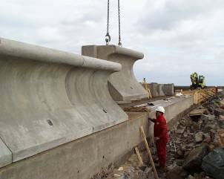
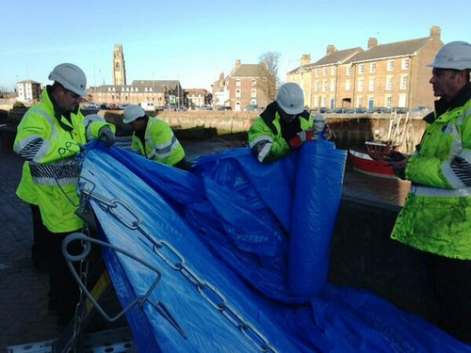
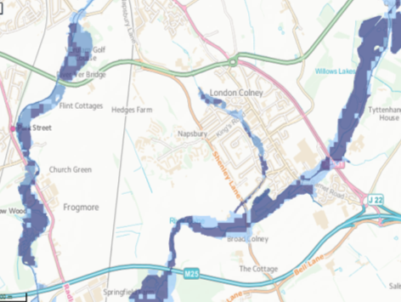



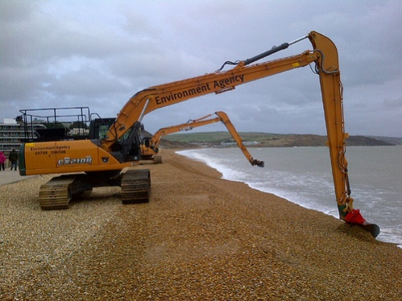
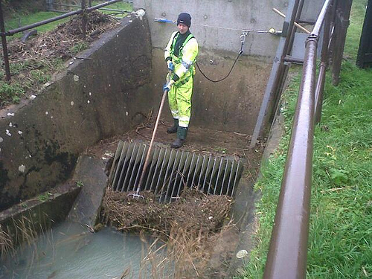
Environment Agency’s role in flood risk management

Slide 3
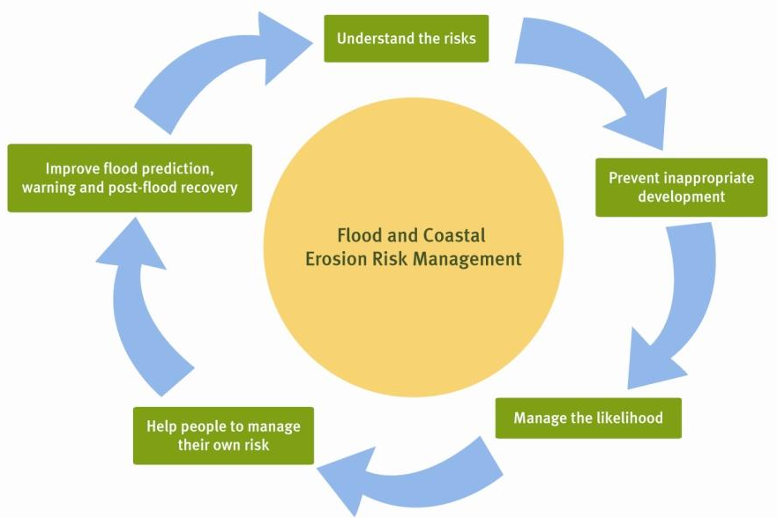

Slide 4
Understanding flood risk
Where should we prioritise our flood risk management investment?
Flooding’s expected – who should we warn?
How much should the nation invest? What happens if we invest more, or less?
Is my house at risk of flooding?
How can we prepare for an emergency?
What can we do to help our community in a flood?

Slide 5
Flood risk modelling

Slide 6
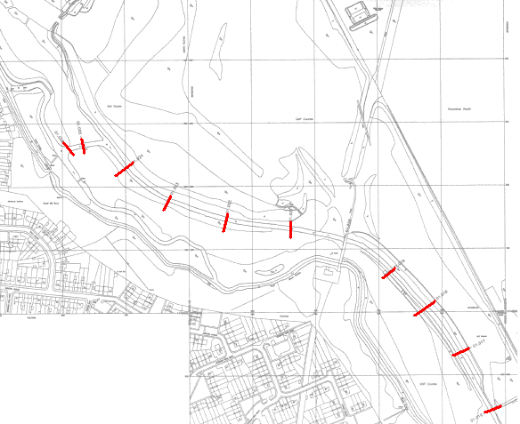
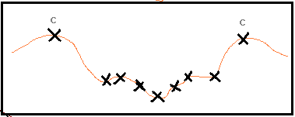
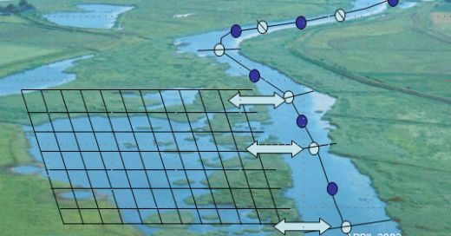
Local flood modelling

Slide 7

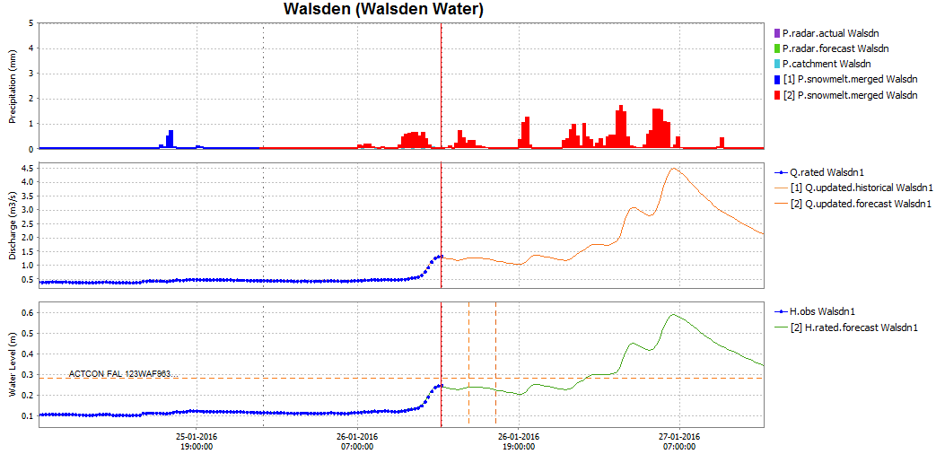
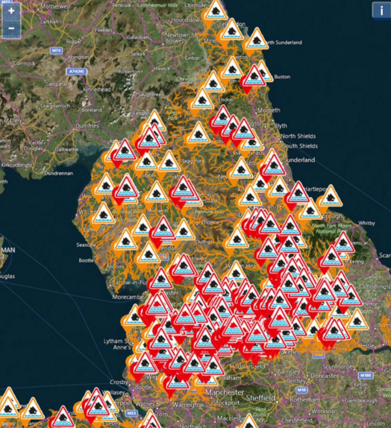
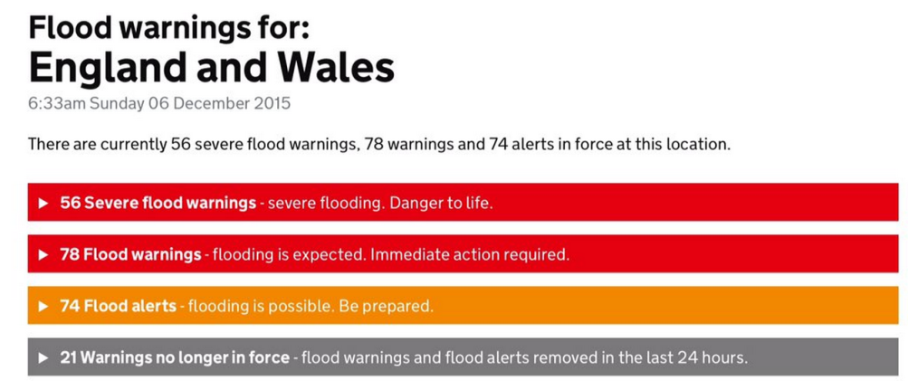
Forecasting and warning

Slide 8
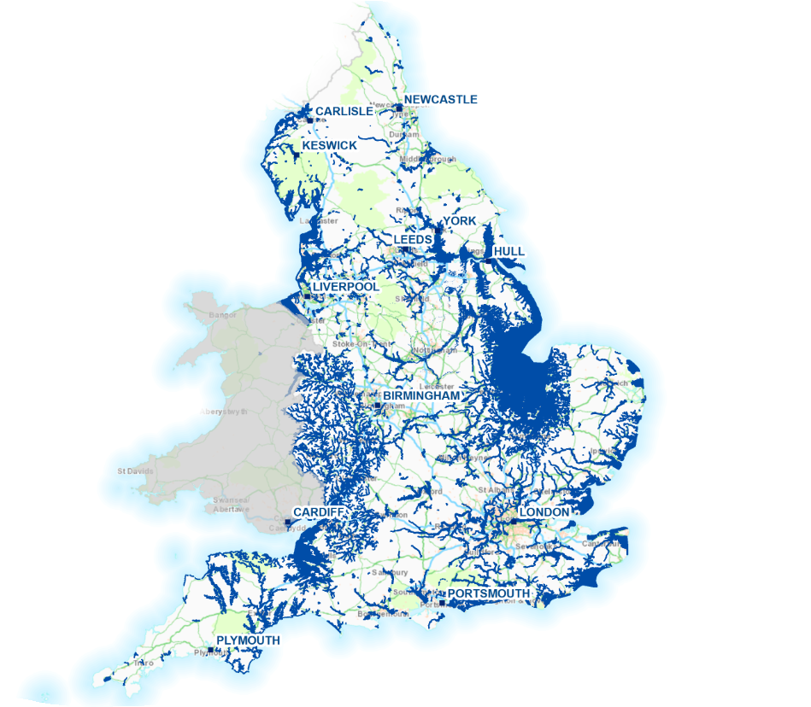

Local hydraulic models
Over 70% of the total floodplain currently covered by local detailed modelling
Over 70% of properties in the floodplain covered by local detailed modelling
Over 2000 models

Slide 9
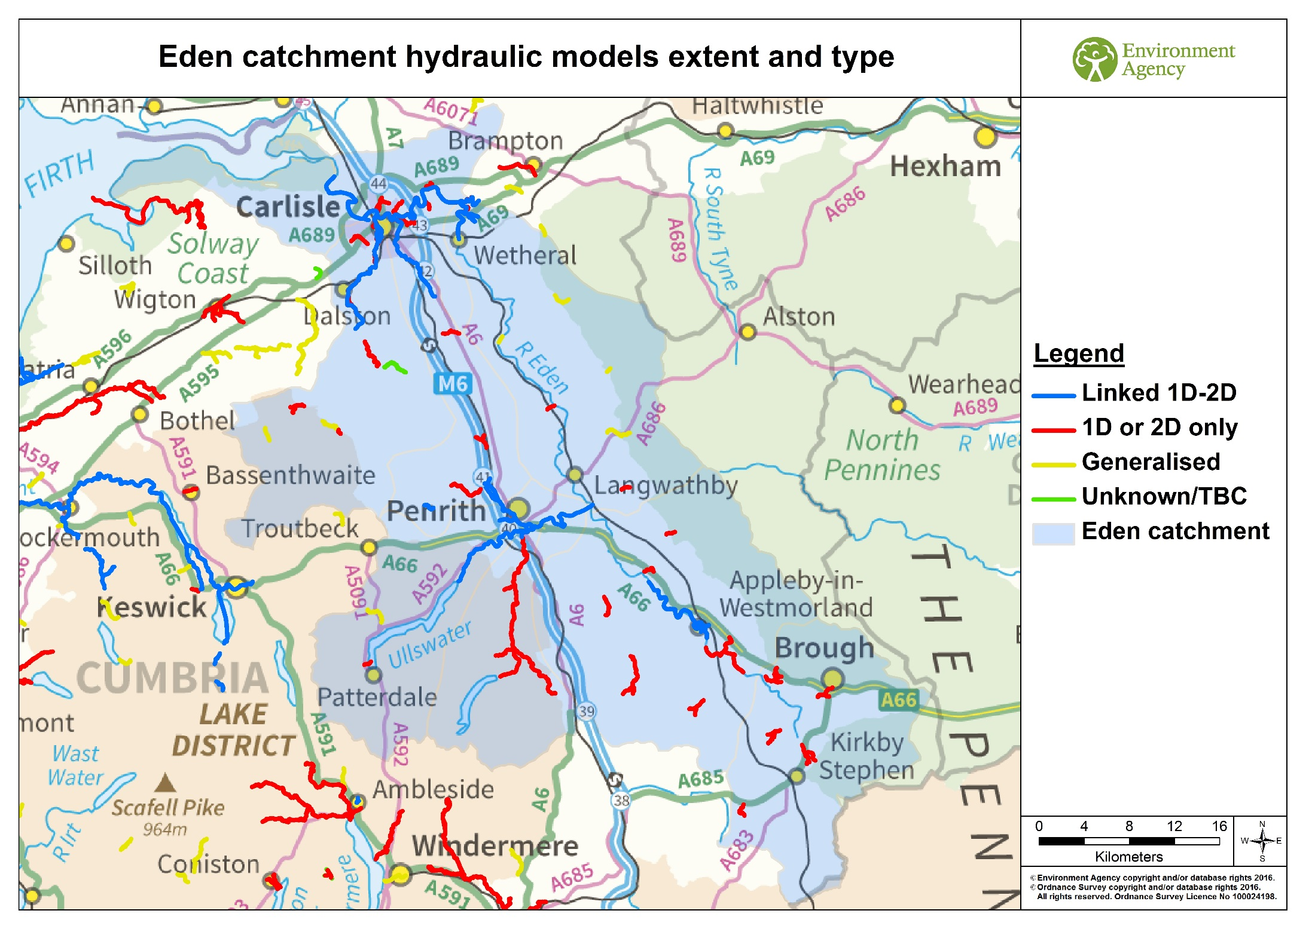

Slide 10
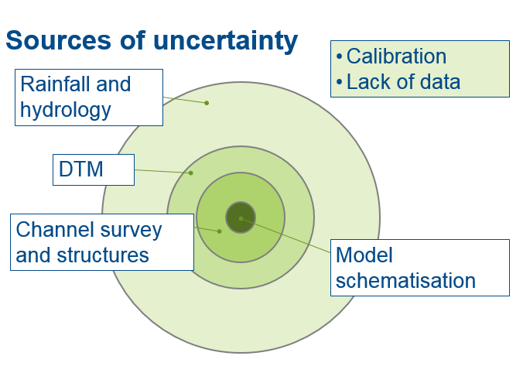
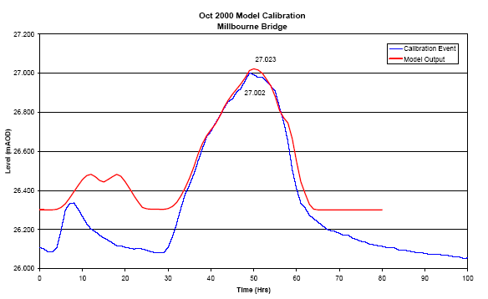
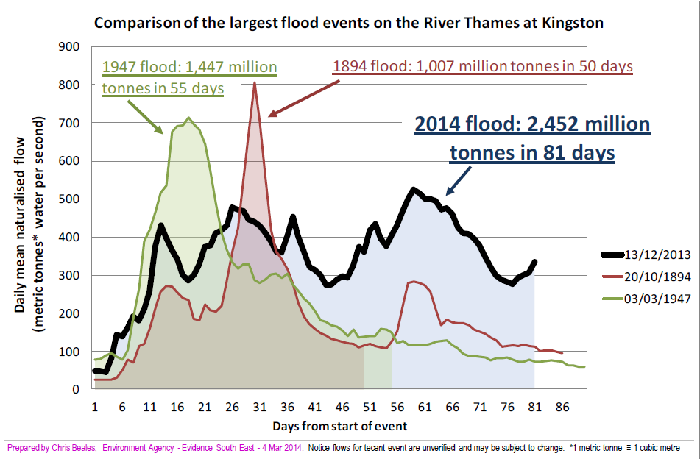
...and every flood is different
Calibration and verification

Slide 11
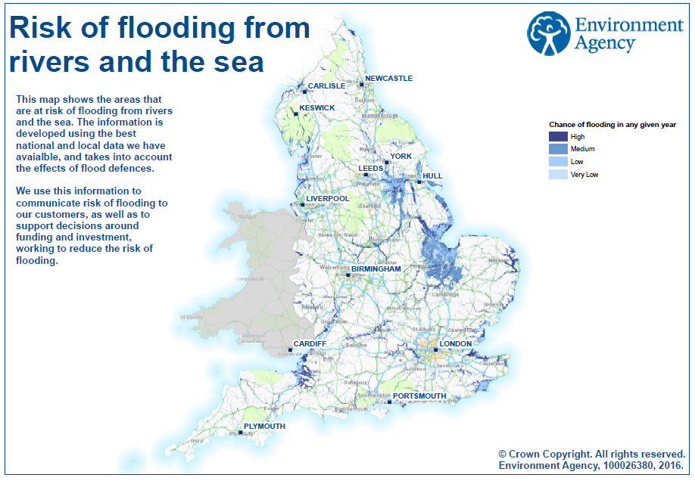

Slide 12
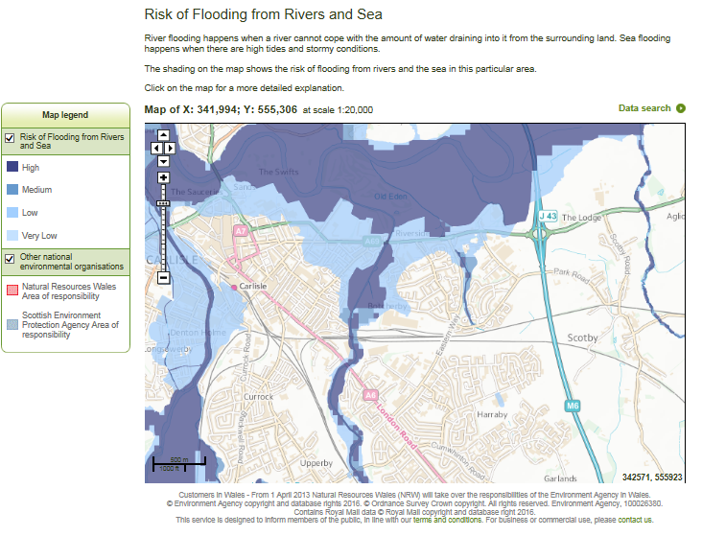

Slide 13
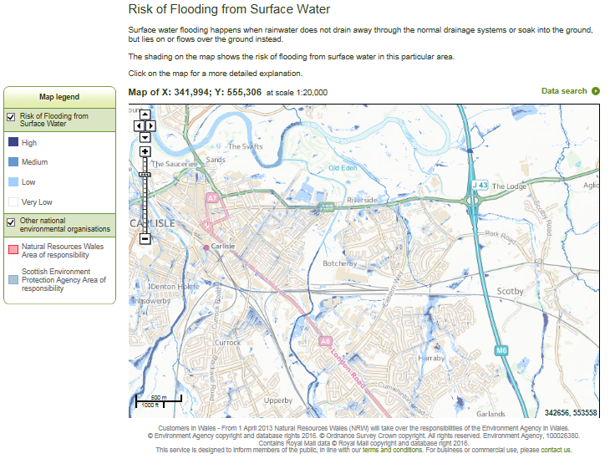
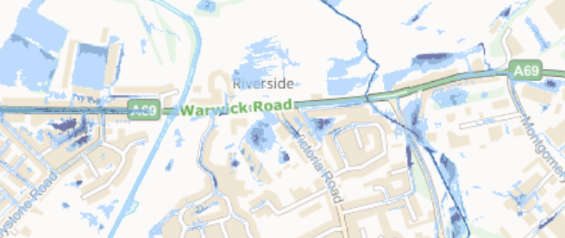

Slide 14
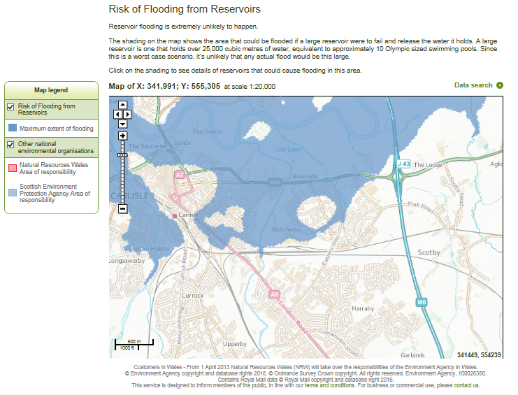

Slide 15

How many properties are at risk?
2.4m properties at risk of flooding from rivers and the sea
3m properties at risk of flooding from surface water
Approx 600,000 properties at risk of flooding from rivers, the sea, and surface water flooding
Approx 23m properties not susceptible to flooding
5m properties at risk of flooding
Notes:
15
15
15

Slide 16
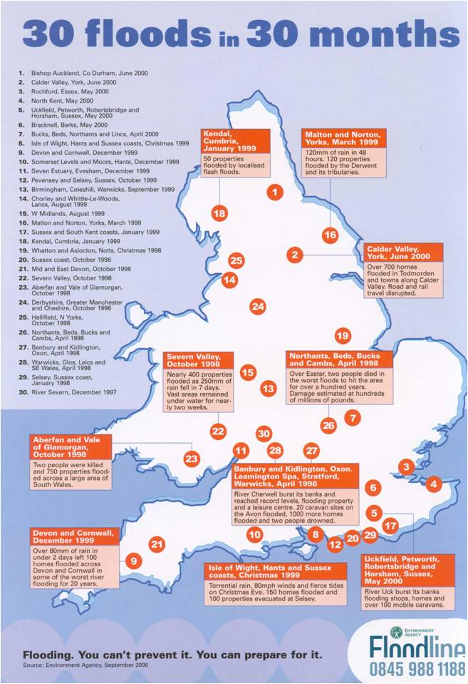
What’s the chance of a big flood occurring somewhere?
Notes:
16
16
16

Slide 17
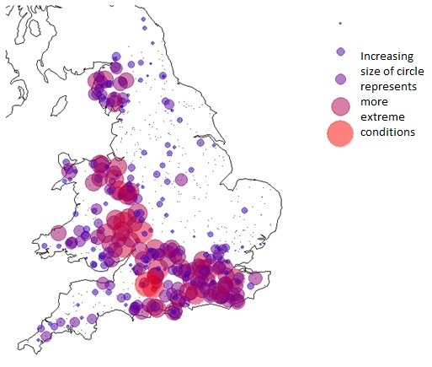
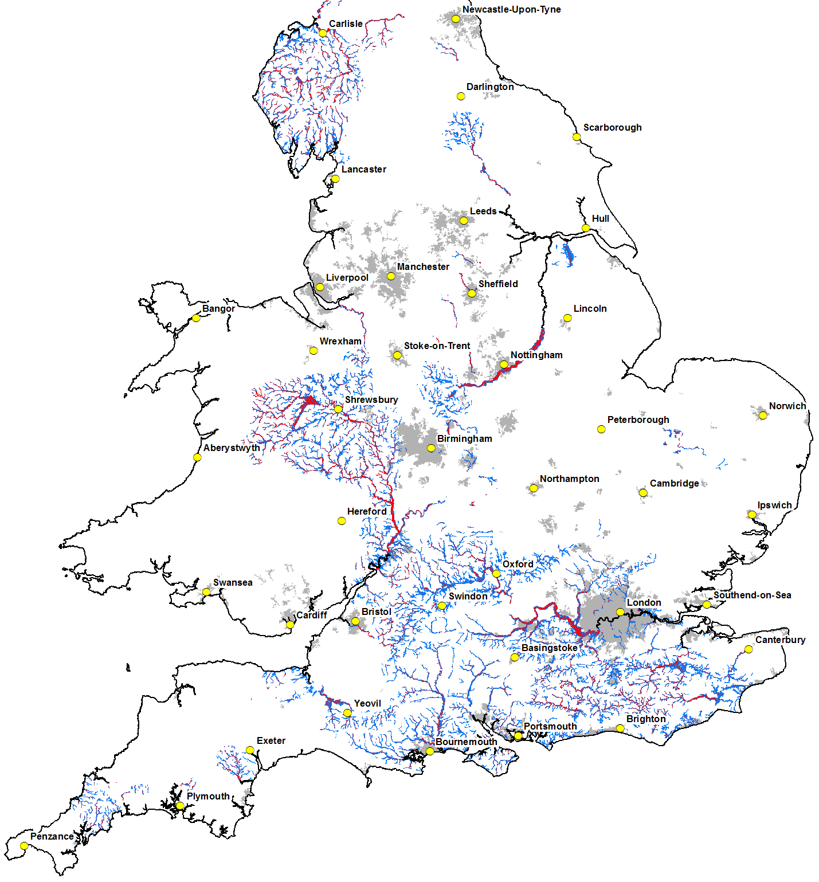
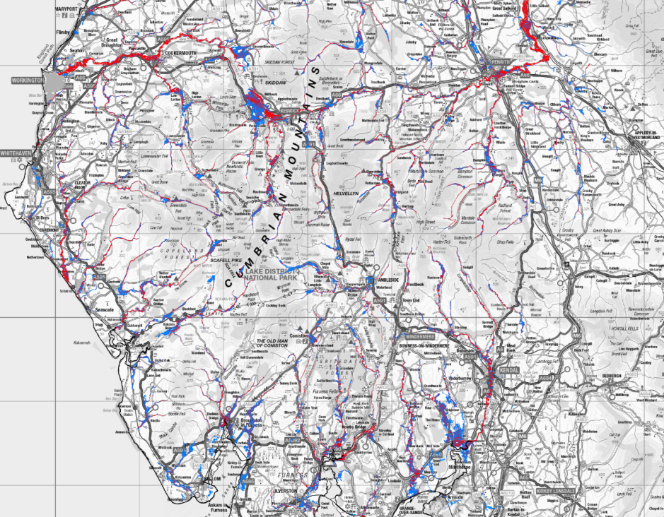
Plausible scenarios for widespread river flooding

Slide 18
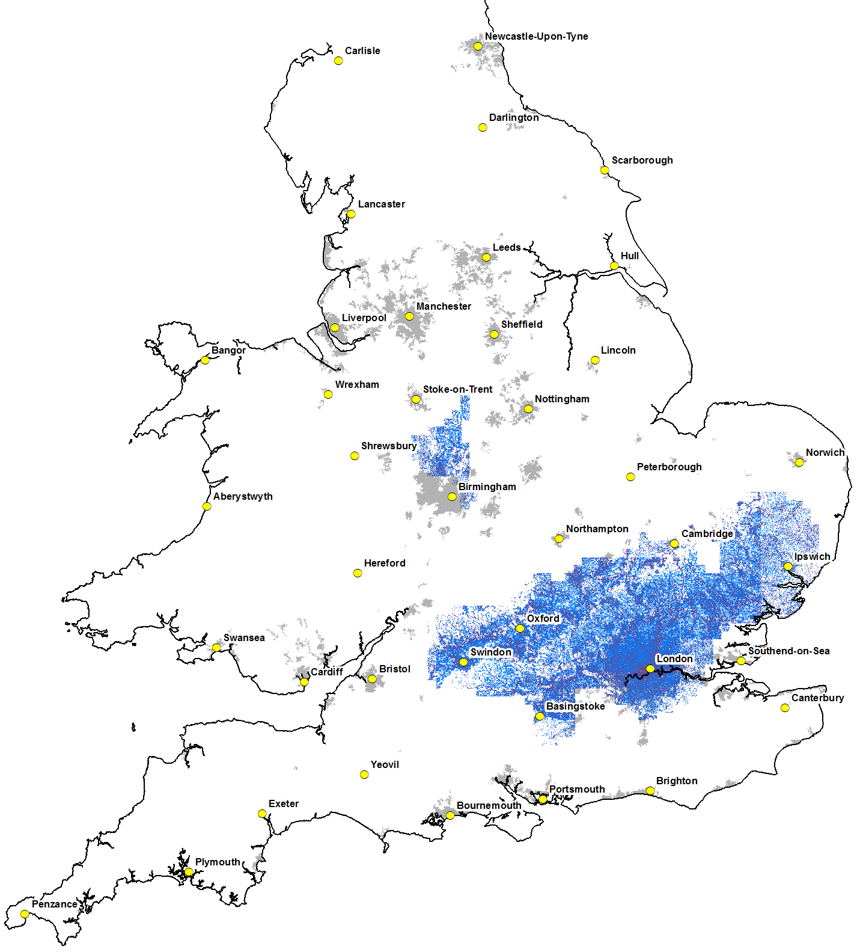
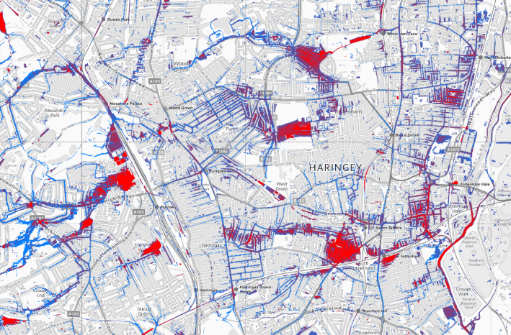

One scenario of widespread surface water flooding over a major city
Shorter forecast lead times
Significant impacts on
transport / infrastructure
Lower awareness and preparedness of communities

Slide 19
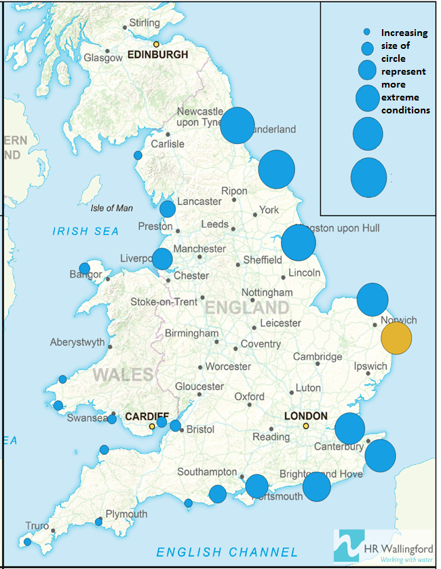
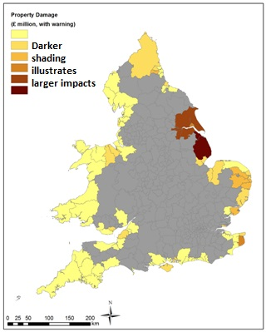
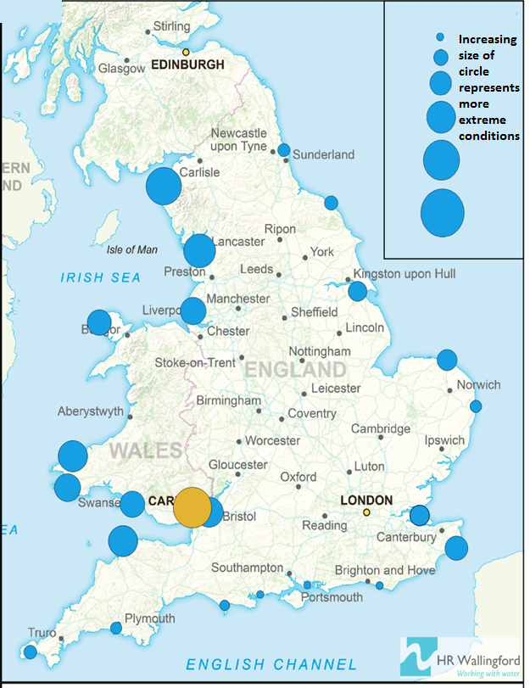
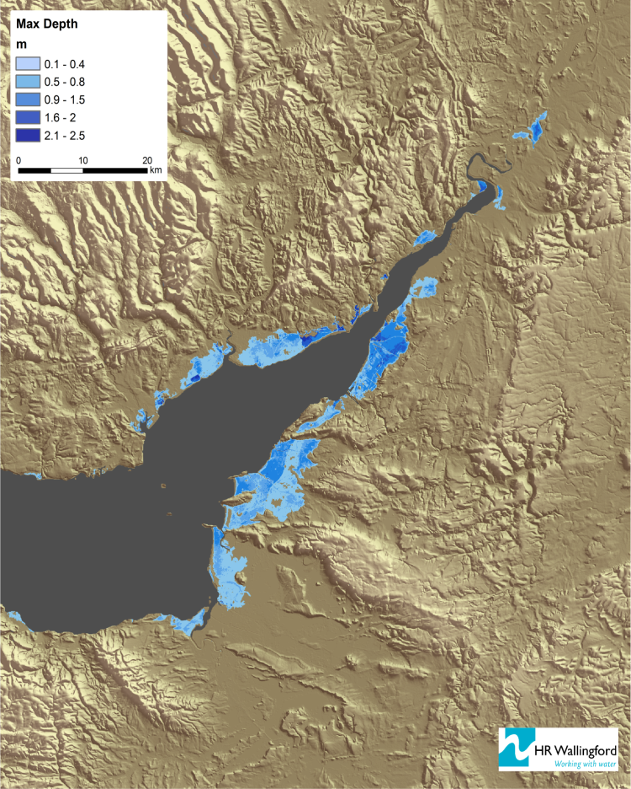
Plausible scenarios for widespread coastal flooding
 | Impacts
Population | Property | Transport
Agriculture | Infrastructure | Economic Costs (CCS)

Slide 20

A few of the findings…
A sound approach for plausible
national scale flood emergencies
Several coasts are at risk of widespread coastal flooding – not just the East Coast
Widespread inland flooding can take many shapes and sizes – don’t just plan for the last event

Slide 21
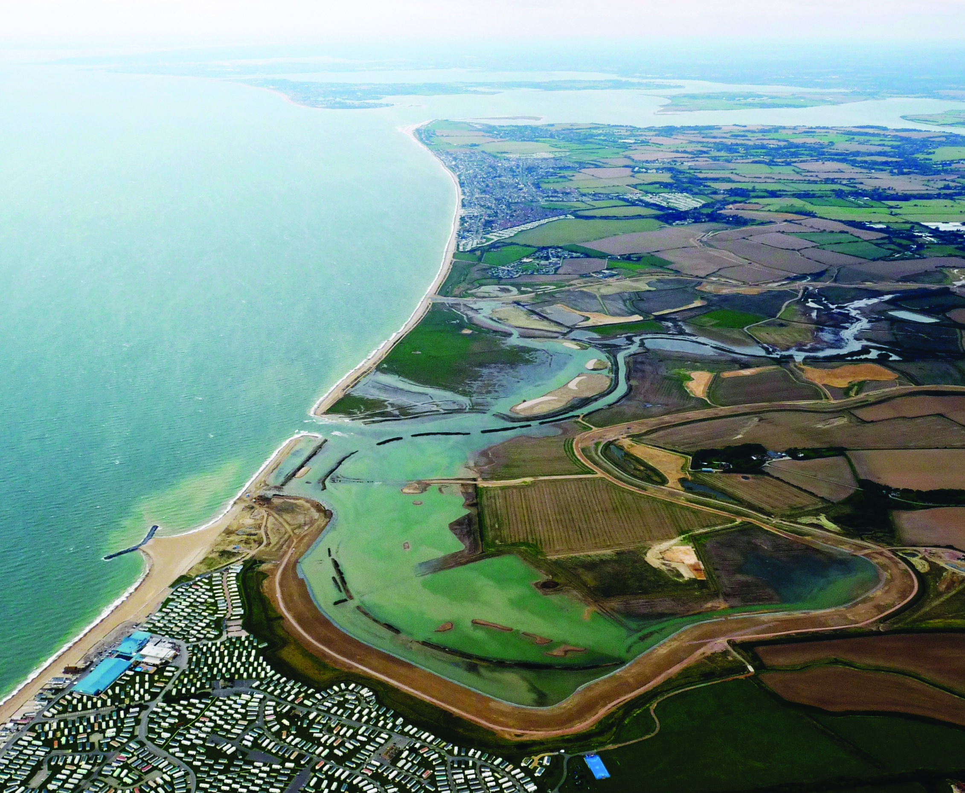
Modelling catchment processes

Slide 22
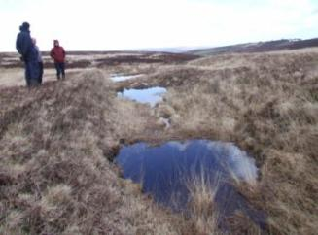
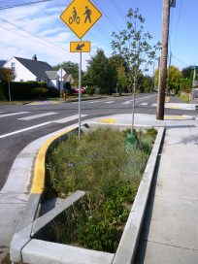
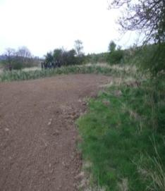
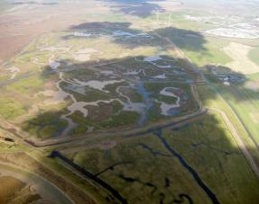
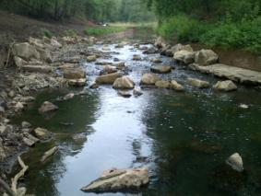
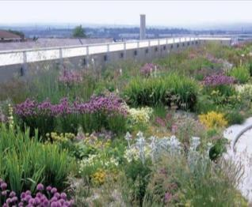


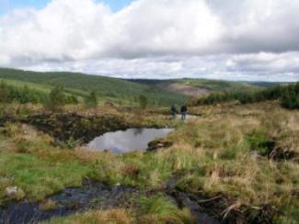
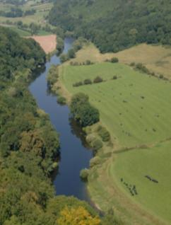
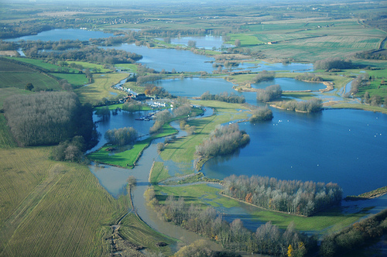
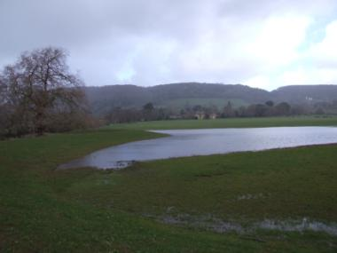
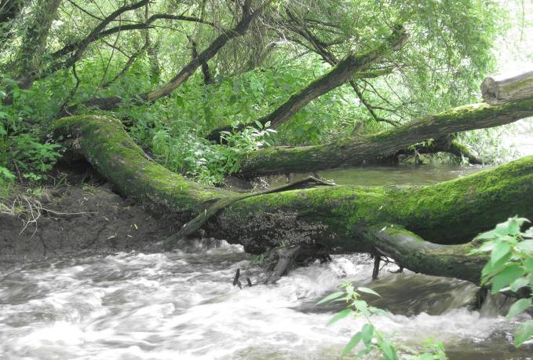
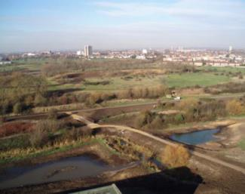
Working with Natural Processes on rivers & their tributaries
Grip blocking
Flow interception
River & floodplain woodlands
Floodplain & wetland restoration
River restoration
Green/blue infrastructure
Suds
Land /soil management
Ponds & runoff attenuation
Woodlands in wider catchment & as flow interception
River & floodplain reconnection
Woody dams
Urban
Flood storage areas
In-channel measures to restore river floodplain connection
Uplands/steep slopes
Floodplain
In-channel
Urban

Slide 23
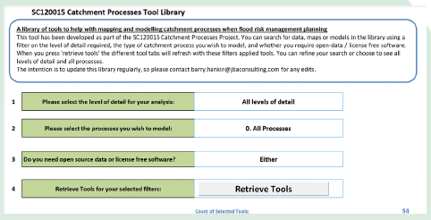
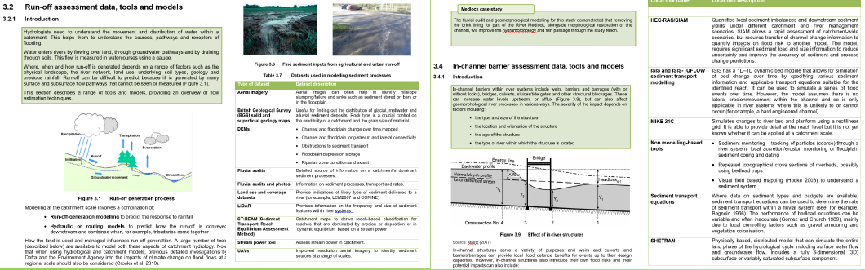
Step 1: Use the model library
Step 2: Read the technical report

Slide 24
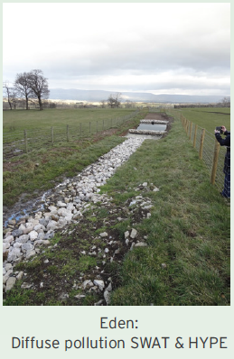
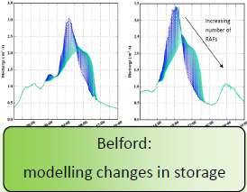
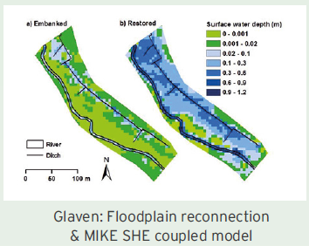

Step 3: Refer to case study examples

Slide 25












What’s next?
Evidence Directory
Opportunity Maps
Catchment & Coastal Labs

Slide 26





Future flood risk assessment
    A single, scalable assessment of flood risk…
    …open, trusted and used

Slide 27
Flood risk data

Slide 28


Slide 29


























LIDAR Composite DSM (various resolutions)
LIDAR Composite DTM (various resolutions)
LIDAR DSM Time Stamped Tiles (various resolutions)
LIDAR DTM Time Stamped Tiles (various resolutions)
Risk of Flooding from Rivers & Sea (RoFRS)
RoFRS properties / postcodes in areas at risk
LIDAR
SURVEY
Dune Slack Likely locations
CASI and LIDAR Habitat map
RoFRS –
Key Summary Info
LIDAR Point Data
Vertical aerial photography
FCRM
MAPPING &
MODELLING
Oblique aerial photography
Remotely Sensed Flood Estimates
384 datasets
2004 Flood Depth grids
Coastal Flood Boundaries
Flood Map for Planning (Rivers and Sea)
Flood Warning / Alert layers and Live Feed
Historic Flooding Data
Real-time River Level and Flow data
Statutory Main River Map
FLOOD FORECASTING & WARNING
3 day flood forecast
National Coastal Erosion Risk Mapping data
PSO Boundaries
Various AIMS spatial data layers
STRATEGY &
INVESTMENT
ASSET MANAGEMENT
RFCC Boundaries
Shoreline Management Plan
Spatial Flood Defences
River and Coastal Maintenance Programme
Areas with critical drainage problems

Slide 30
Notes:
The Data Sharing Platform (DSP), discovery via data.gov.uk
Partner Data providing for professional partners to cookie cut and download spatial data. Also includes the provision of Web Map Services (WMS) and Web Feature services (WFS) for integration in to end user services
Sharefile is our ‘simple download service’: a space we can publish data to quickly and cost effectively for user download
The Lined Data Platform (LDS) comprises a number of datasets, APIs and applications, where data is published as 5 Star Linked Data ‘under the hood’. By publishing data in this way we can contribute to the semantic web of data: end users – usually developers – can access and re-use our data, integrate in to services, and we reach much greater environmental outcomes as a result. Examples of our Linked Data Services are Bathing Water Quality, the Catchment Data Explorer and our near real-time Flood Data APIs. We’ll say more about those on the next few slides
Survey Open Data provides access to LIDAR and further data will be added this year. This is all available under the OGL
The Spatial Data Catalogue contributes to Defra compliance to the INSPIRE Directive, providing spatial data from across the network to download, or via WMS and WFS data feeds
The Metadata Service enables people to find our data: data.gov.uk harvests our Metadata at time periods we specify, to ensure our data holdings are discoverable through this public interface
To note: some people may have been familiar with our DataShare Service: we no longer operate this portal for the discovery of our data, instead, our services operate seamlessly ‘behind the scenes’ to the user. Data is discoverable via data.gov.uk, a user will select their data here, and will be taken to the appropriate service. However, because all of our services are branded consistently, the experience is seamless and appears as a single service

Slide 31

Notes:
This is an example of cookie cutting spatial data that is discoverable via data.gov.uk

Slide 32

Notes:
Our Flood Data APIs, as part of the Linked Data Service, are discoverable via data.gov.uk
Extensive documentation is signposted from here to our pages at environment.data.gov.uk
Those familiar in working within APIs will be able to access 5 Star Linked Data near real-time feeds, updated every 15 minutes, of flood warnings, river level flows and the current 3 day forecast.
There is also a daily archive of river level data available here.

Slide 33


Slide 34
Where to get the data from
Open data:
APIs – discoverable via data.gov.uk
Spatial – discoverable via data.gov.uk
Conditional Licence data:
Spatial – via Fileshare, url to be provided
Local models – upon request, process to be confirmed

Slide 35


Slide 36
Thank you
Shirley Greenwood
Flood and Coastal Risk Management – Expert Advisor
Environment Agency

Slide 37



National Flood Resilience Review
“This Government is strengthening our country’s flood defences, including spending £2.3bn over the next six years. This new review will make sure communities are as protected as they can be from the kind of extreme weather we saw last December.”
Oliver Letwin, Chancellor of the Duchy of Lancaster
“We need to be sure we have the best possible plans in place for flood prevention and protection across the whole country. This Review will identify any gaps in our approach and pinpoint where our defences and modelling need strengthening, allowing us to take prompt action.”
Environment Secretary Elizabeth Truss

